Slide 1
File Signature Analysis

Slide 2

Objective
By the end of this module, participants will be able to search digital evidence for changes in file extensions

Slide 3

File Types Overview
Files are accessed by applications and identified by their type (header and extension)
The Windows environment binds a file to an application using its extension

Slide 4
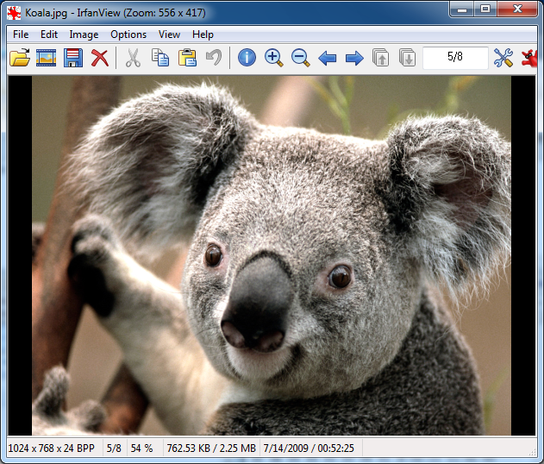
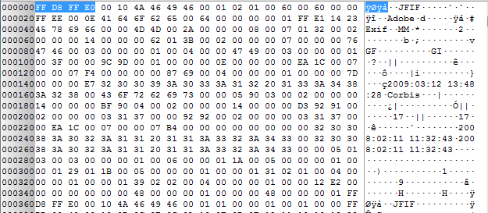
File Header
Digital signature that applications use to uniquely identify files of a specific type
Typically located in the header (or first few bytes of the file)

Slide 5
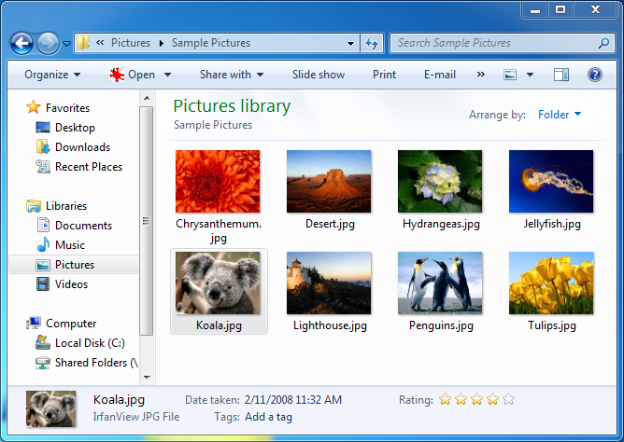
File Extension
Part of the filename that is also typically used to identify the file’s type
The file header and extension should match
Example: koala.jpg → JPEG picture file
koala.jpg

Slide 6
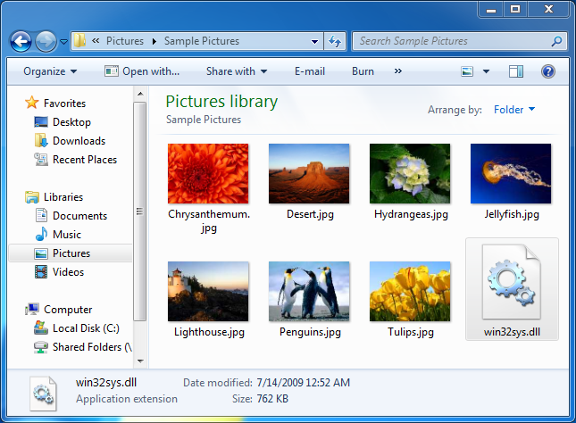
Investigative Consideration
Windows relies on the extension—NOT the header
Data can be hidden by changing the filename and extension
Example: koala.jpg → win32sys.dll
Binary content of koala.jpg remains the same
Windows will now treat the file as a dynamically linked library

Slide 7
Investigative Software
Digital forensics software:
Analyzes file headers to correctly identify data
win32sys.dll ←→ JPG Header = MISMATCH!!
Installs with a default set of common file signatures
Allows examiners to create customized signature searches

Slide 8
Summary
File signature analysis:
Is a critical component of digital forensics
Quickly identifies files that might have been intentionally hidden
Can decrease the data set for analysis

Slide 9
Thanks!
Any questions?

